Slide 1
Capstone Project- The Battle of Neighborhoods
By Vijayalakshmi Rajagopal

Slide 2
Introduction
The following capstone project is part of the Coursera Applied Data Science Course, which is part of the IBM Data Science Professional Certification.
The ideas is to think of a fictious business problem of a client and solve it using data & Foursquare API
The goal of the following project is so find out the best locations for a sushi bar in manhattan, New york

Slide 3
Business Problem
My client wants to open his business in Manhattan area. So I focus on that borough during my analysis. We define potential neighbourhood based on the number of sushi bars which are operating right in coach neighbourhood.
Manhattan has full potential but also is a very challenging district to open a business because of high competition.
New sushi bar should be open in an area that inadequate neighbourhood in this way the bar can attract more customers .
Therefore, this analysis necessary to ensure that we have enough customers and we are not so close to other sushi places.

Slide 4
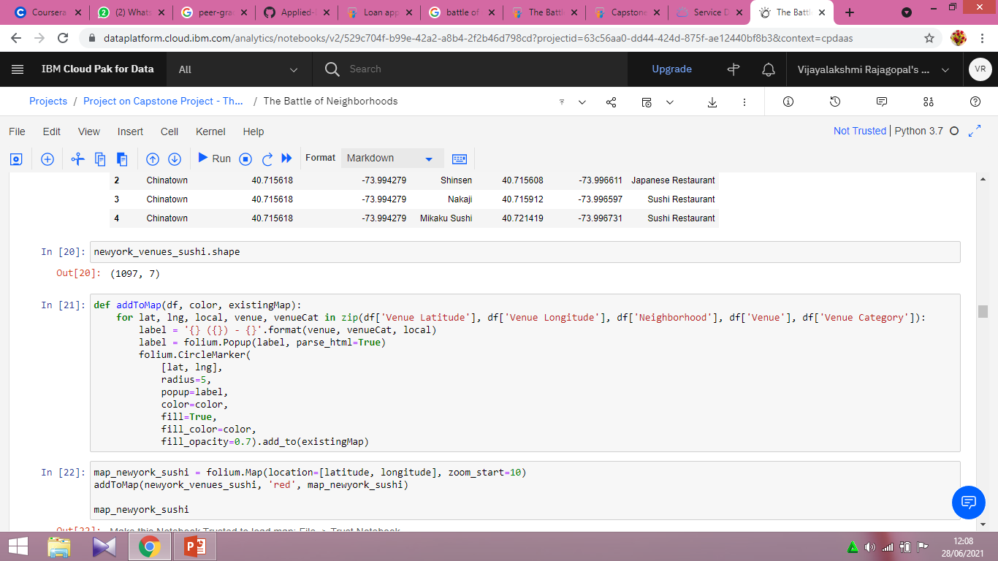
Data
To identify the characteristics of our competitors' venues in Manhattan, we would first need to find out the number of sushi bars in Manhattan currently and their location.
We then used Google Map API to find their geographic coordinates based on their postal code addresses.
In Manhattan, there is 1097 sushi bars are currently operating.

Slide 5
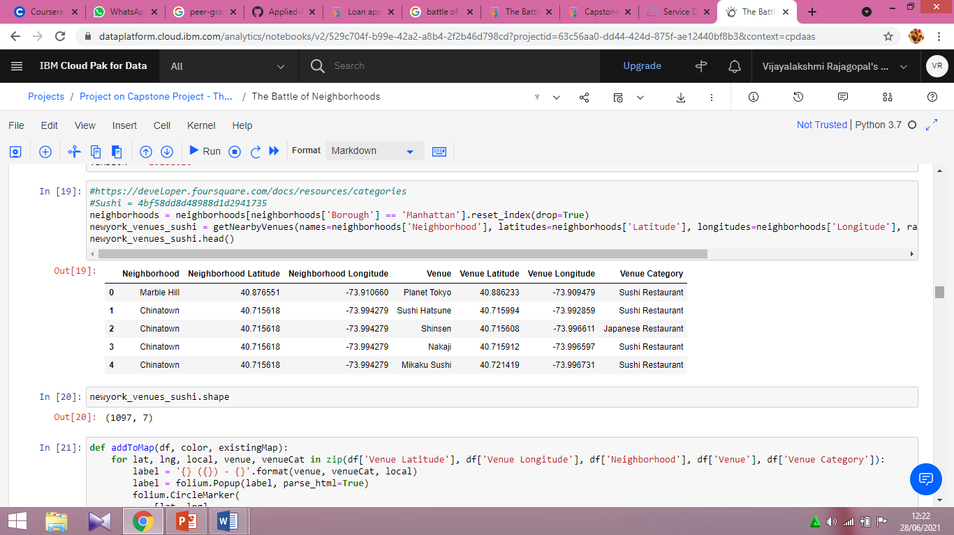
Data Selection
Next, we also used Google Map API to find their geographic coordinates of the 5 locations shortlisted for our sushi bar:

Slide 6
Methodology
Addresses are converted into their equivalent latitude and longitude values.
Foursquare API is used to explore neighborhoods in Manhattan, New York.
After that, explore function to get sushi restaurant categories in each neighborhood.

Slide 7
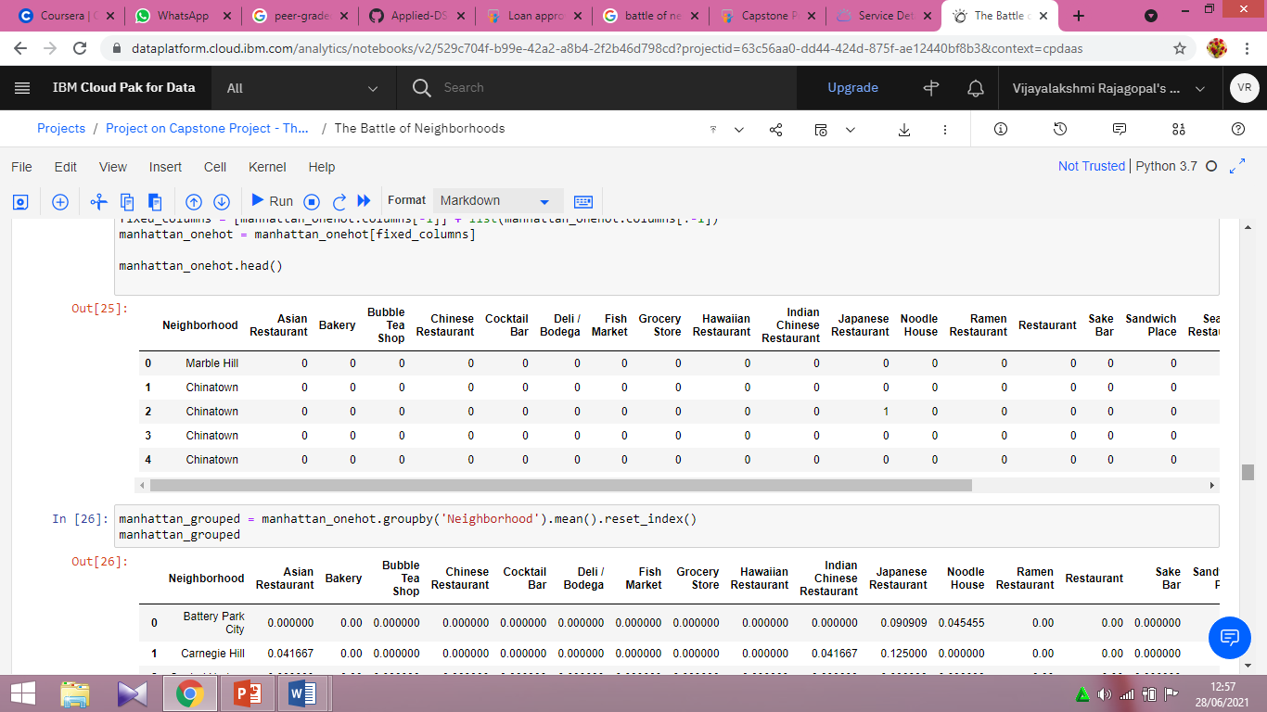
Methodology

Slide 8
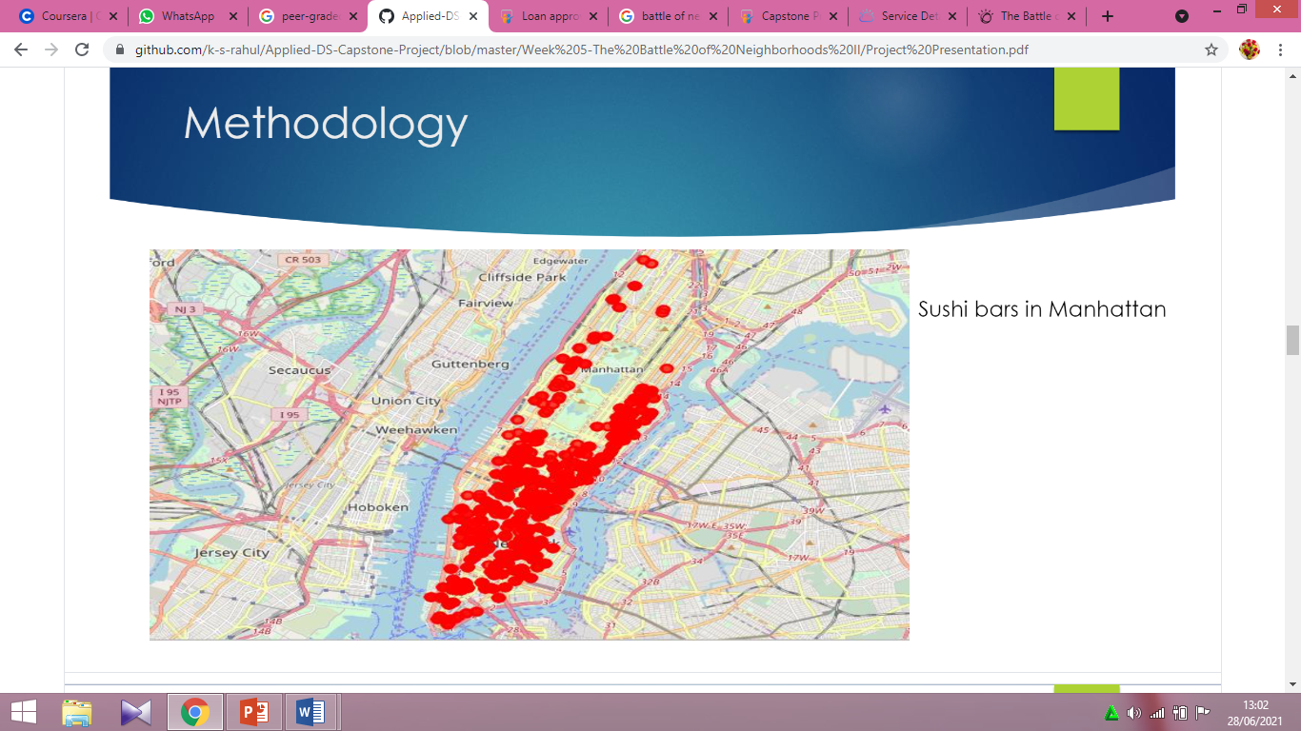
Methodology (Sushi bars in Manhattan)

Slide 9
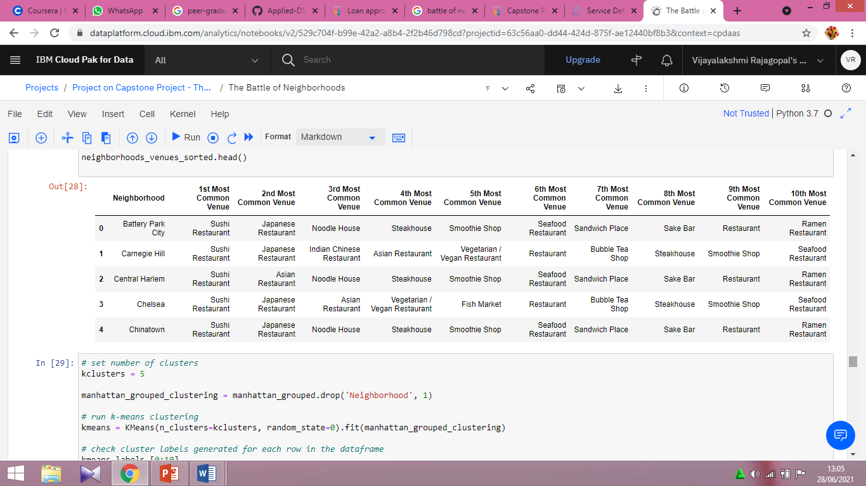
Methodology
Then using this feature to group the neighborhoods into clusters K-means clustering algorithm will be use to complete this task. And also, the Folium library to visualize the neighborhoods in Manhattan and its emerging clusters.

Slide 10
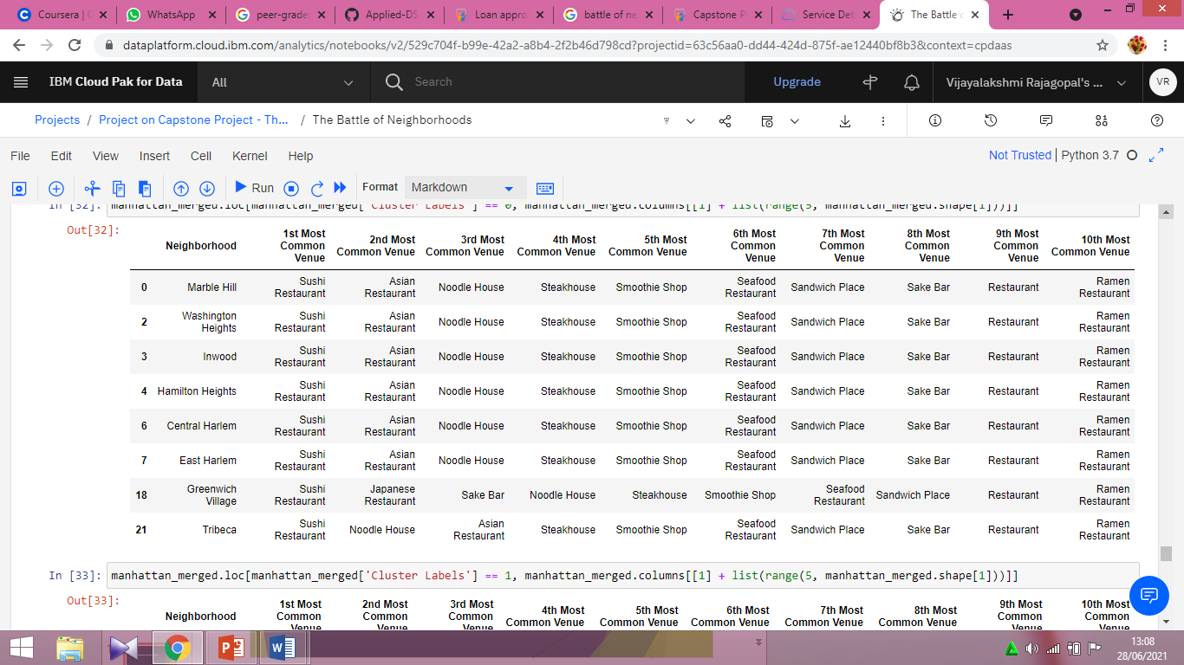
Results
Using K-mean to clustering data area with less number of sushi bars
Cluster 0

Slide 11
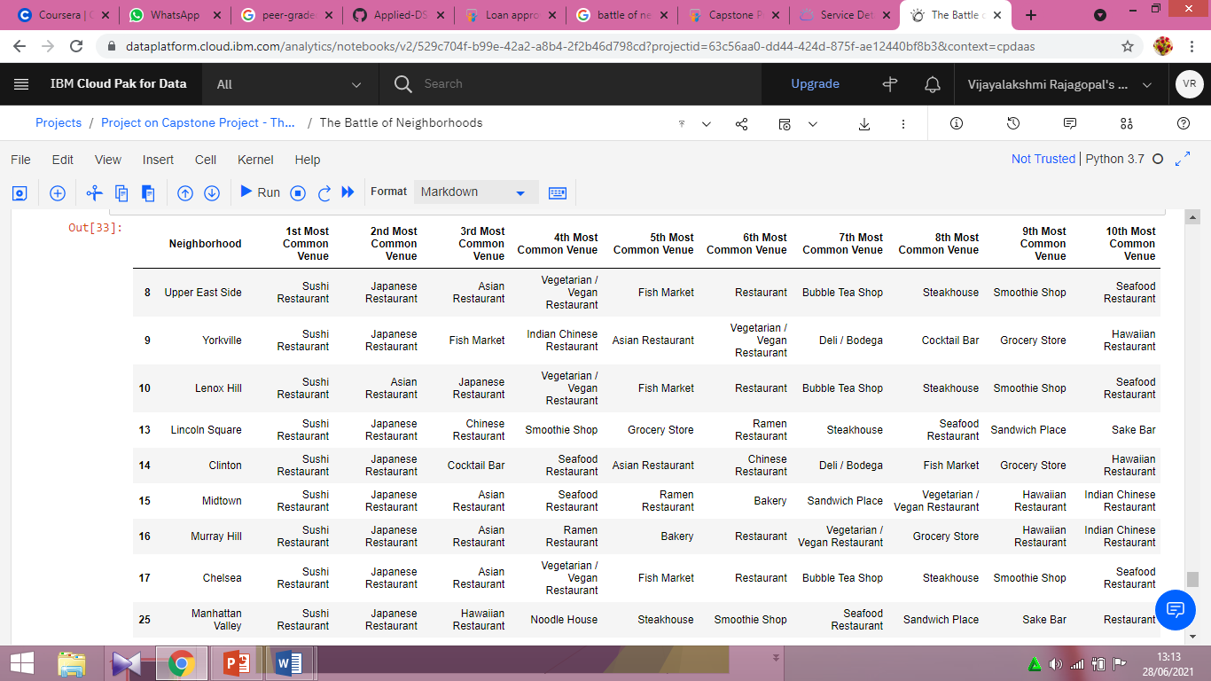
Result
Cluster 1

Slide 12
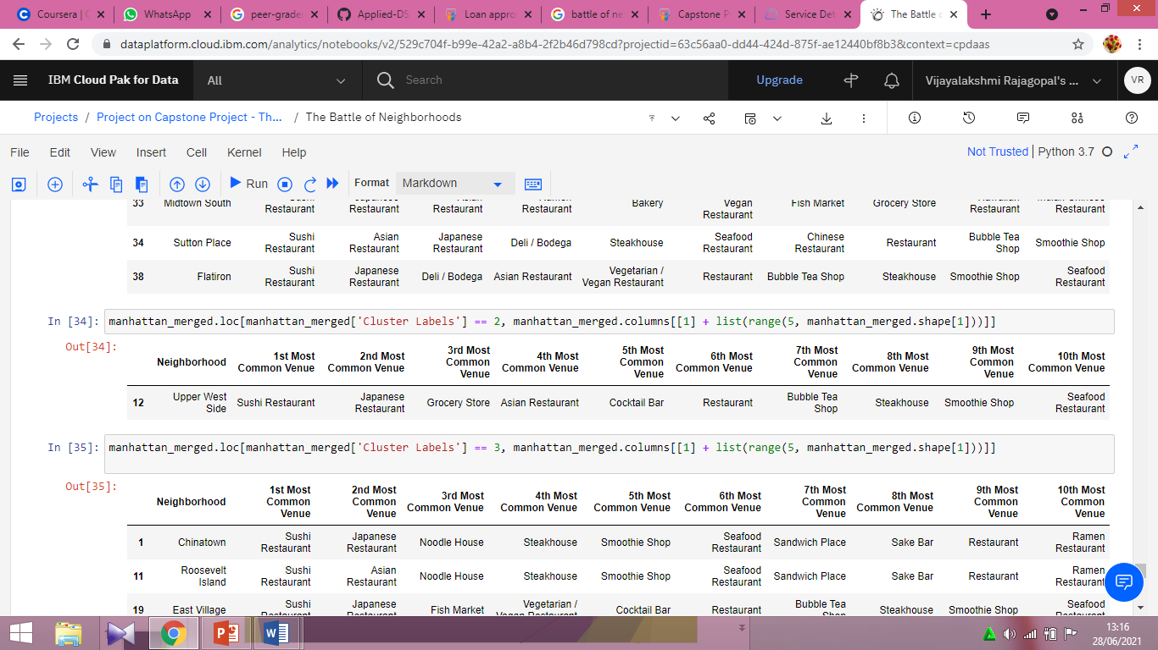
Result
Cluster 2

Slide 13
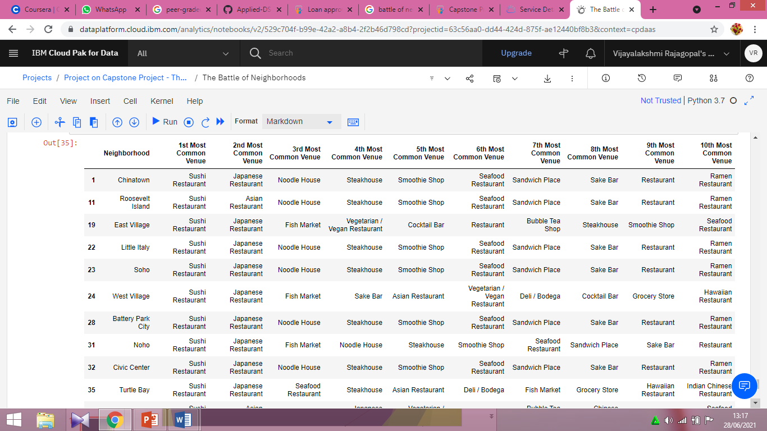
Result
Cluster 3

Slide 14
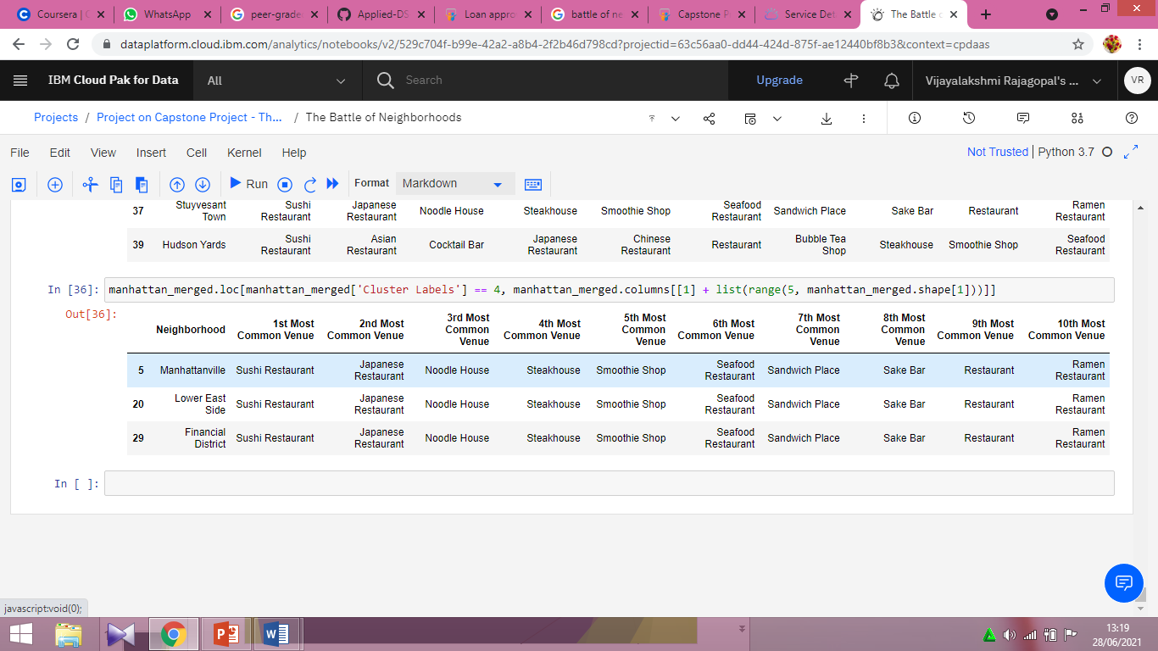
Result
Cluster 4

Slide 15
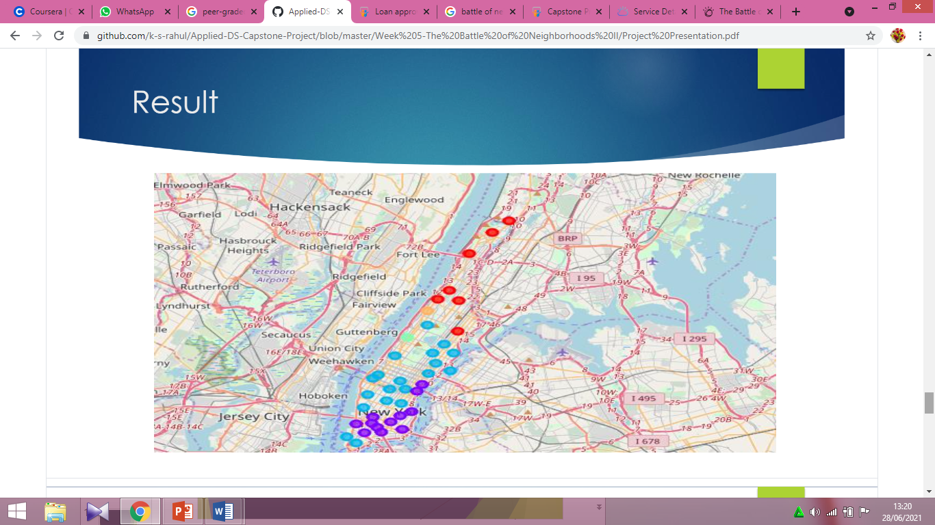
Result

Slide 16
Discussion
This analysis is performed on limited data. This may be right or may be wrong. But if good amount of data is available there is scope to come up with better results.
There is high competition in Midtown and Soho so it is very risky to open business in these areas.
Central Harlem has also potential where closes to Morningside Heights area.
It can be done more detailed analysis by adding other factors such as transportation, demographics of inhabitants

Slide 17
Conclusion
Although all of the goals of this project were met there is definitely room for further improvement and development as noted below. However, the goals of the project were met and, with some more work, could easily be developed into a fully pledged application that could support the opening a business idea in an unknown location.

